Slide 1

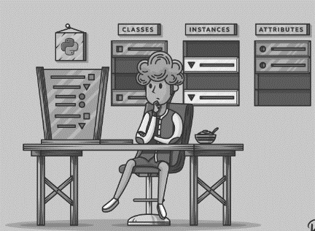
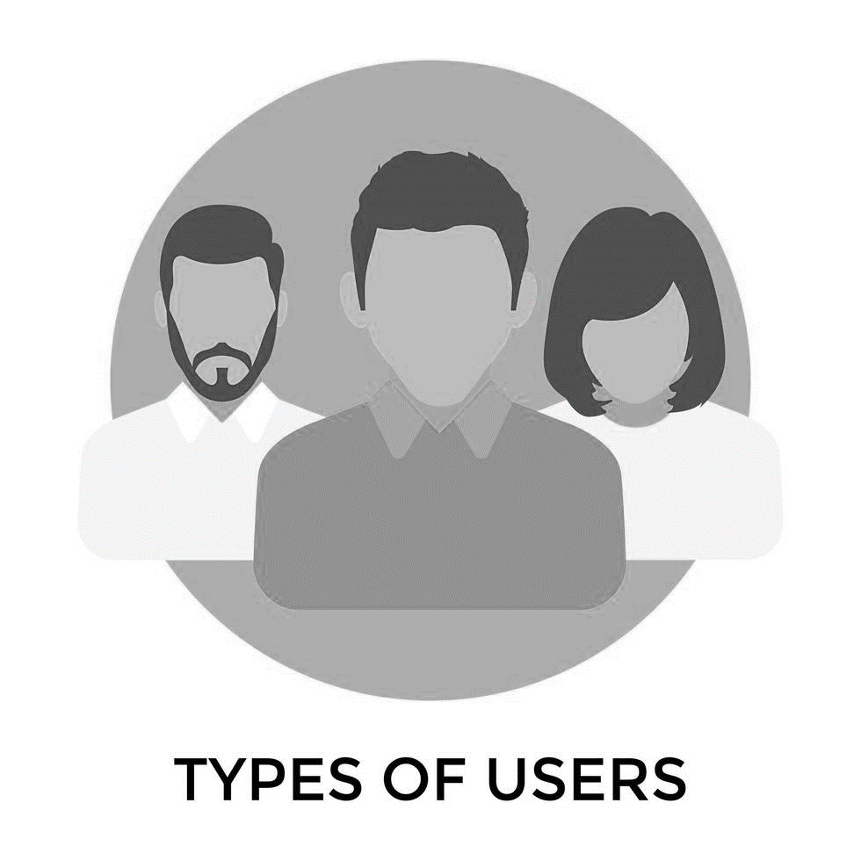
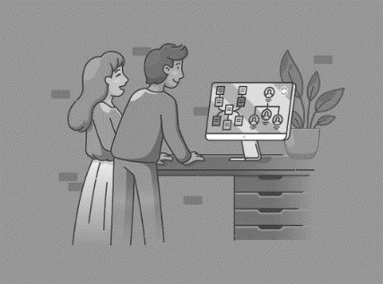
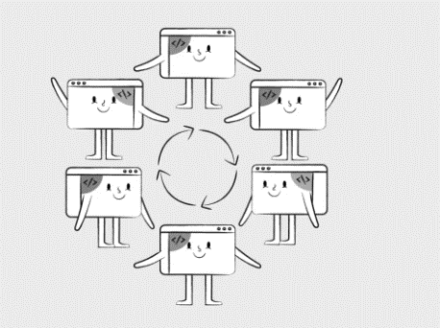
Sequence Diagram

Slide 2


Class Diagram

Slide 3

Use Case Diagram

Slide 4

State Diagram

Slide 5

Activity Diagram

Slide 6
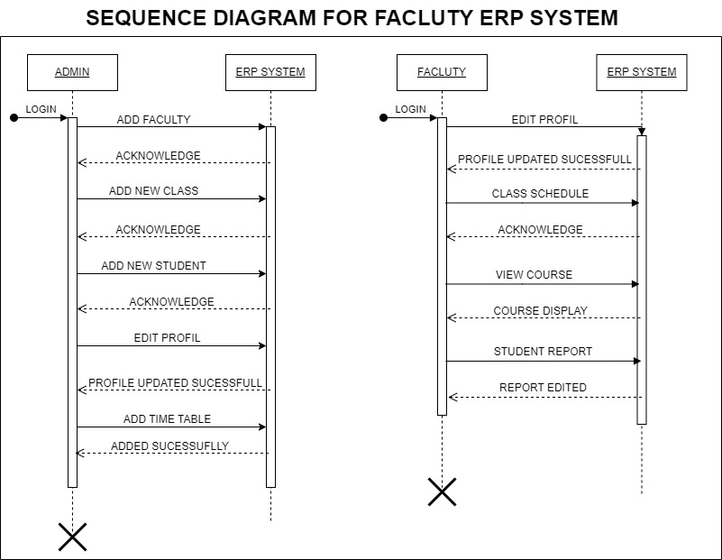
4 SEQUENCE DIAGRAM
A Sequence Diagram for a Faculty ERP System depicts the chronological flow of interactions between various system components, including actors and objects.
It illustrates the specific sequence of messages or actions exchanged during a particular use case, like "Student Course Registration." This diagram provides a dynamic view, highlighting the order and timing of activities in the system, aiding in understanding its functionality and data flow.

Slide 7
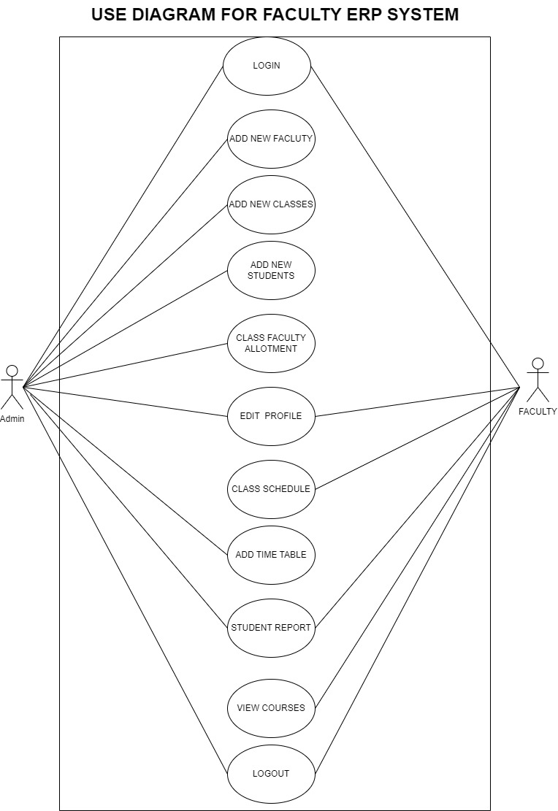
UML DIAGRAMS OF FACULTY ERP SYSTEM
1 USE CASE DIAGRAM
A Use Case Diagram for a Faculty ERP System illustrates interactions between users and the system.
Actors like professors, administrators, and students engage in various use cases, including course registration, grade management, and attendance tracking.
This diagram visually represents how the ERP system serves and connects these stakeholders in a university setting.

Slide 8
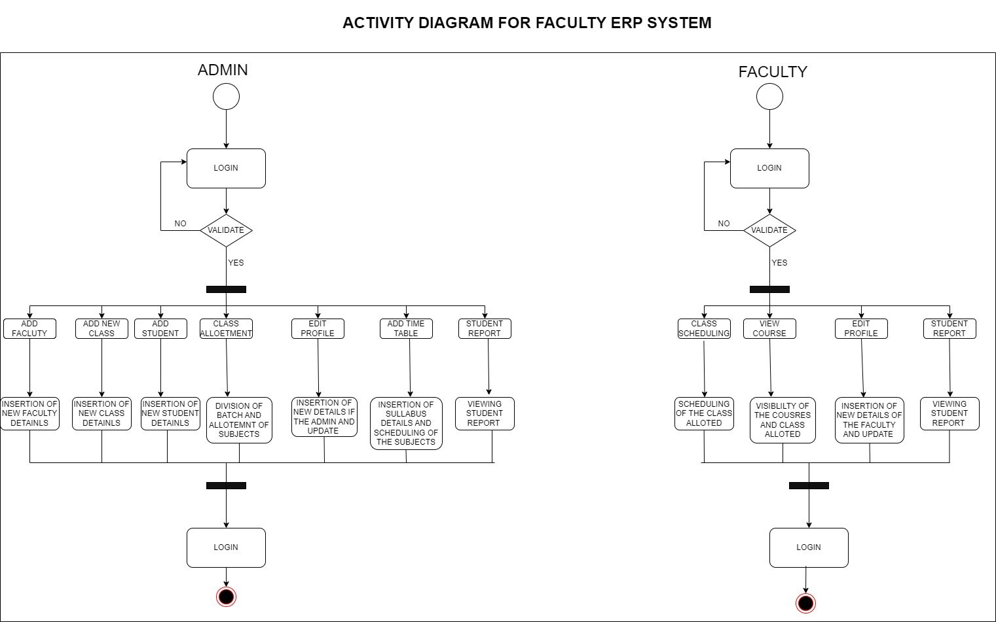
2 ACTIVITY DIAGRA
The activity diagram consists of the the functions that a user can perform
The admin has the most of the access of the dashboard including all the features of the system
The faculty has all the class related and courses view options

Slide 9
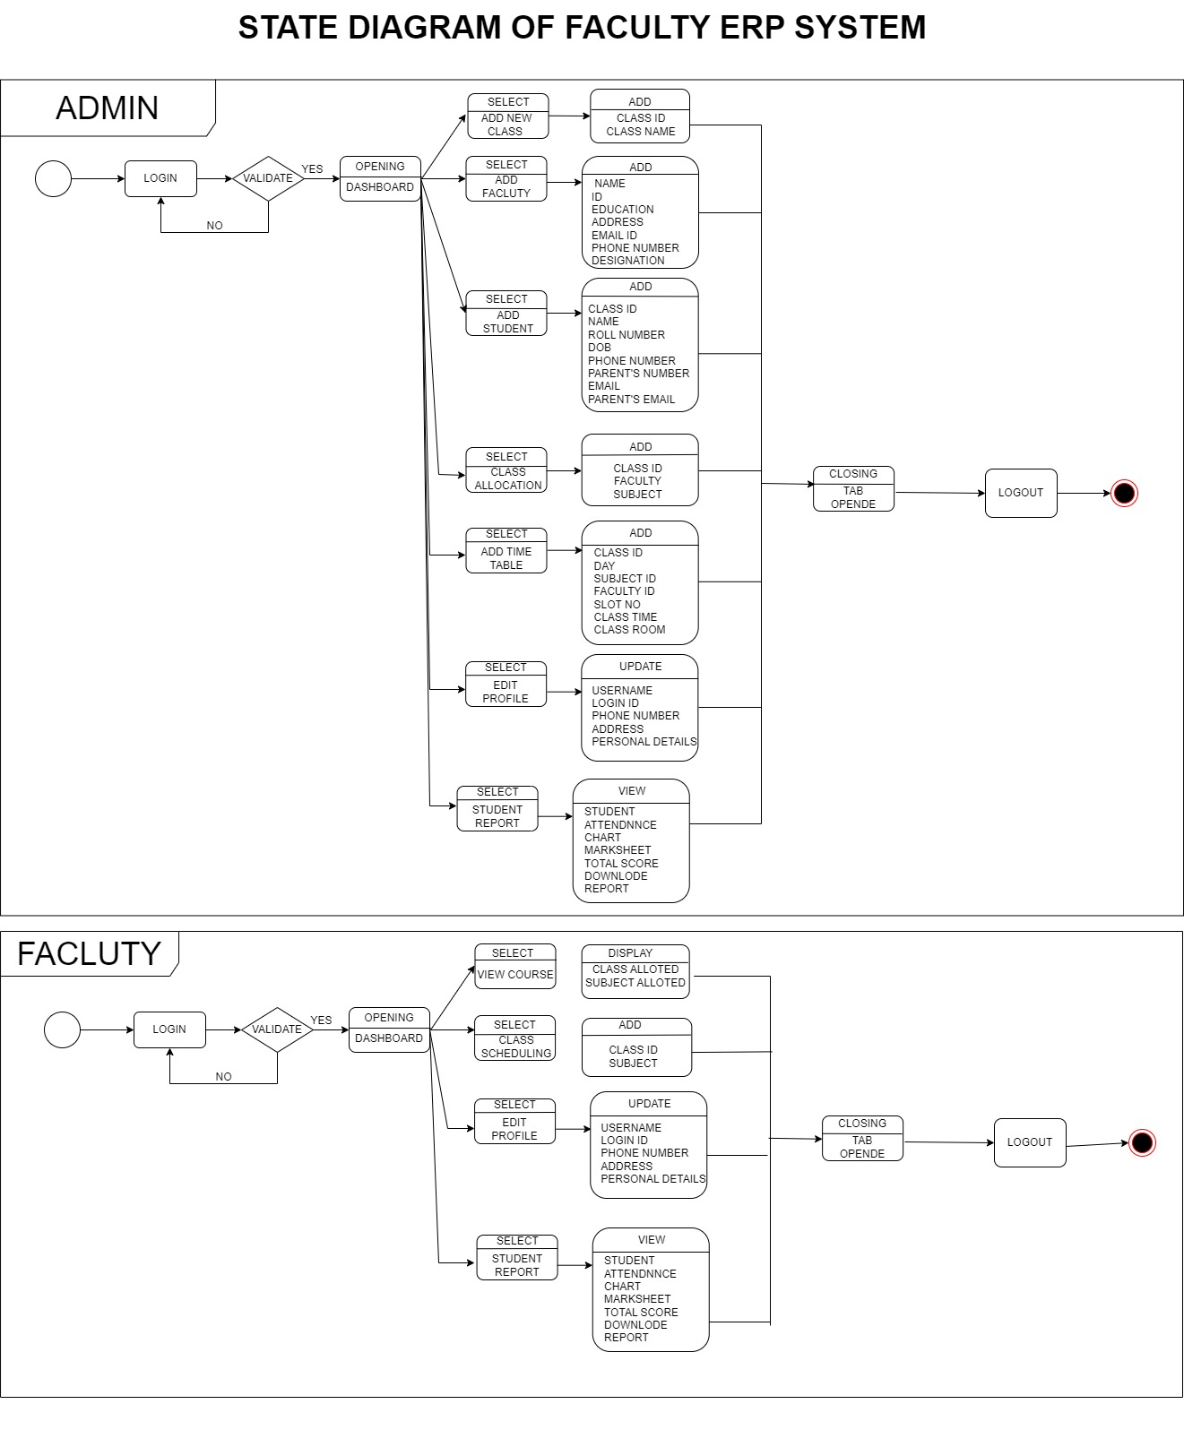
3 STATE DIAGRAM
A State Diagram for a Faculty ERP System outlines the different states a component or entity within the system can exist in and the transitions between these states. For instance, a “Add new Faculty" component may transition from "Open for Registration" to "Closed for Registration." This diagram clarifies the system's behavior and helps in understanding its operational states and transitions.

Slide 10
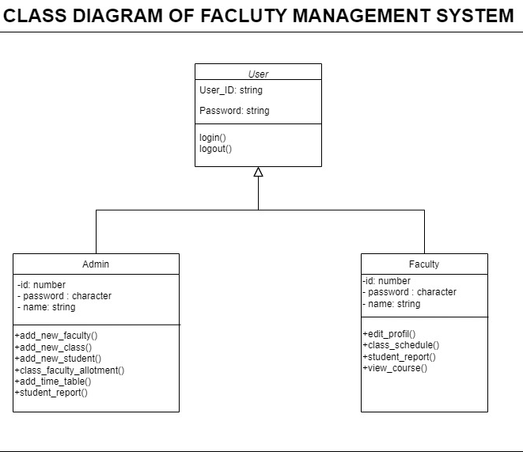
5 CLASS DIAGRAM
A Class Diagram for a Faculty ERP System represents the system's structure and the relationships between its classes or objects.
It identifies the major components, such as "Student," "Professor," "Course," and their attributes and methods. Arrows between classes indicate associations, like a student being enrolled in a course.
This diagram offers a static view, helping to visualize the system's data structure and the way different elements are connected.

